Slide 1
IMPORTANT PROVISIONS
OF
POSTAL BALLOT & E-VOTING
BY: DHRUMIL M. SHAH & CO.
Practising Company Secretaries, Trade Marks Agent
ADD: R-2 / 710| Golden Building | Garodia Nagar|
Nr. Orbit Tower| Ghatkopar (E)| Mumbai -400077
Mob:9820177898|LL: 2232555760|
www.dmshah.in | Email Id: cs@dmshah.in

Slide 2
POSTAL BALLOT

Slide 3
The following items of business shall be transacted only by means of voting through a postal ballot.
Alteration of the objects clause of the memorandum and in the case of the company in existence immediately before the commencement of the Act, alteration of the main objects of the memorandum;
Alteration of articles of association in relation to insertion or removal of provisions which, under sub-section (68) of section 2, are required to be included in the articles of a company in order to constitute it a private company;
Change in place of registered office outside the local limits of any city, town or village as specified in sub-section (5) of section 12;
Change in objects for which a company has raised money from public through prospectus and still has any unutilized amount out of the money so raised under sub-section (8) of section 13;
Issue of shares with differential rights as to voting or dividend or otherwise under sub-clause (ii) of clause (a) of section 43;

Slide 4
The following items of business shall be transacted only by means of voting through a postal ballot. (……Contd)
Variation in the rights attached to a class of shares or debentures or other securities as specified under section 48;
Buy-back of shares by a company under sub-section (1) of section 68;
Election of a director under section 151 of the Act;
Sale of the whole or substantially the whole of an undertaking of a company as specified under sub-clause (a) of sub-section (1) of section 180;
Giving loans or extending guarantee or providing security in excess of the limit specified under sub-section (3) of section 186:

Slide 5
POSTAL BALLOT PROCEDURE

Slide 6
BUSINESS REPLY PERMIT
To apply the Business Reply permit from the post office in whose jurisdiction the registered office of the company is situated.
If the Business Reply is already there, then check the validity of the same.

Slide 7
Where a company is required or decides to pass any resolution by way of postal ballot, it shall send a notice to all the shareholders, along with a draft resolution explaining the reasons therefore and requesting them to send their assent or dissent in writing on a postal ballot because postal ballot means voting by post or through electronic means within a period of thirty days from the date of dispatch of the notice.
The notice shall be sent either (a) by Registered Post or speed post, or (b) through electronic means like registered e-mail id or (c) through courier service

Slide 8
An advertisement shall be published at least once in a vernacular newspaper in the principal vernacular language of the district in which the registered office of the company is situated, and having a wide circulation in that district, and at least once in English language in an English newspaper having a wide circulation in that district, about having dispatched the ballot papers and specifying therein the following matters, namely :
(a) a statement to the effect that the business is to be transacted by postal ballot which includes voting by electronic means;
(b) the date of completion of dispatch of notices;
(c) the date of commencement of voting;
(d) the date of end of voting;
(e) the statement that any postal ballot received from the member beyond the said date will not be valid and voting whether by post or by electronic means shall not be allowed beyond the said date;
(f) a statement to the effect that members, who have not received postal ballot forms may apply to the company and obtain a duplicate thereof; and
(g) contact details of the person responsible to address the grievances connected with the voting by postal ballot including voting by electronic means.

Slide 9
The notice of the postal ballot shall also be placed on the website of the company forthwith after the notice is sent to the members and such notice shall remain on such website till the last date for receipt of the postal ballots from the members.
The Board of directors shall appoint one scrutinizer, who is not in employment of the company and who, in the opinion of the Board can conduct the postal ballot voting process in a fair and transparent manner.
The scrutinizer shall be willing to be appointed and be available for the purpose of ascertaining the requisite majority.
If a resolution is assented to by the requisite majority of the shareholders by means of postal ballot including voting by electronic means, it shall be deemed to have been duly passed at a general meeting convened in that behalf.
Postal ballot received back from the shareholders shall be kept in the safe custody of the scrutinizer and after the receipt of assent or dissent of the shareholder in writing on a postal ballot, no person shall deface or destroy the ballot paper or declare the identity of the shareholder.
The scrutinizer shall submit his report as soon as possible after the last date of receipt of postal ballots but not later than seven days thereof.

Slide 10
The scrutinizer shall maintain a register either manually or electronically to record members assent or dissent received including complete details of the shareholders.
The postal ballot and all other papers relating to postal ballot including voting by electronic means, shall be under the safe custody of the scrutinizer till the chairman considers, approves and signs the minutes .
The assent or dissent received after thirty days from the date of issue of notice shall be treated as if reply from the member has not been received.
The results shall be declared by placing it, along with the scrutinizer’s report, on the website of the company
The resolution shall be deemed to be passed on the date of at a meeting convened in that behalf.

Slide 11
E-VOTING
Rule 20 of Companies (Management and Administration) Rules, 2014.

Slide 12
Every listed company or a company having not less than one thousand shareholders, shall provide to its members facility to exercise their right to vote at general meetings by electronic means.
A member may exercise his right to vote at any general meeting by electronic means and company may pass any resolution by electronic voting system in accordance with the provisions of this rule

Slide 13
A company which opts to provide the facility to its members to exercise their votes at any general meeting by electronic voting system shall send notice of the meeting to all the members, auditors of the company, or directors either
(a) by registered post or speed post ; or
(b) through electronic means like registered e-mail id;
(c) through courier service;
The notice shall also be placed on the website of the company, if any and of the agency forthwith after it is sent to the members.
The notice of the meeting shall clearly mention that the business may be transacted through electronic voting system and the company is providing facility for voting by electronic means.
The notice shall clearly indicate the process and manner for voting by electronic means and the time schedule including the time period during which the votes may be cast and shall also provide the login ID and create a facility for generating password and for keeping security and casting of vote in a secure manner

Slide 14
The company shall cause publish an advertisement , not less than five days before the date of beginning of the voting period, at least once in a vernacular newspaper in the principal vernacular language of the district in which the registered office of the company is situated, and having a wide circulation in that district, and at least once in English language in an English newspaper having a wide circulation in that district, about having sent the notice of the meeting and specifying therein, inter alia, the following matters, namely:-
(a) statement that the business may be transacted by electronic voting;
(b) the date of completion of sending of notices;
(c) the date and time of commencement of voting through electronic means;
(d) the date and time of end of voting through electronic means;
(e) the statement that voting shall not be allowed beyond the said date and time;
(f) website address of the company and agency, if any, where notice of the meeting is displayed; and
(g) contact details of the person responsible to address the grievances connected with the electronic voting;

Slide 15
The e-voting shall remain open for not less than one day and not more than three days. Provided that in all such cases, such voting period shall be completed three days prior to the date of the general meeting .
During the e-voting period, shareholders of the company, holding shares either in physical form or in dematerialized form, as on the record date, may cast their vote electronically. Provided that once the vote on a resolution is cast by the shareholder, he shall not be allowed to change it subsequently.
At the end of the voting period, the portal where votes are cast shall forthwith be blocked.
The Board of directors shall appoint one scrutinizer, who is not in employment of the company and in the opinion of the Board can scrutinize the e-voting process in a fair and transparent manner:

Slide 16
The scrutinizer shall, within a period of not exceeding three working days from the date of conclusion of e-voting period, unblock the votes in the presence of at least two witnesses not in the employment of the company and make a scrutinizer’s report of the votes cast in favour or against, if any, forthwith to the Chairman.
The scrutinizer shall maintain a register either manually or electronically to record the assent or dissent.
The register and all other papers relating to electronic voting shall remain in the safe custody of the scrutinizer until the chairman considers, approves and signs the minutes.
The results declared along with the scrutinizer’s report shall be placed on the website of the company and on the website of the agency within two days of passing of the resolution at the relevant general meeting of members.
Subject to receipt of sufficient votes, the resolution shall be deemed to be passed on the date of the relevant general meeting of members .

Slide 17
FORMATES
&
TENTATIVE CONTENTS

Slide 18
NEWSPAPER ADVERTISEMENT
NAME OF THE company
Notice to the members
NOTICE is hereby given to the members of the Company pursuant to Section 108 of the Companies Act, 2013 read with the Companies (Management and Administration) Rules, 2014 that the Company has on ____ 2014 completed the dispatch by Registered Post/Courier or where the e-mail address of the members have been registered with Company’s Registrar
and Transfer Agents, through electronic mail, of a Notice Under Section 108 of the Companies Act, 2013, along with the requisite Explanatory Statement, seeking approval of the members by Special Resolution for _____________. Where the Notice is dispatched by post, the same is accompanied by a Postal Ballot Form and self-addressed postage prepaid reply envelope.
Voting through postal ballot or by electronic mode shall commence on _______, 2014 and end on ________, 2014. Votes received thereafter will be treated as if the same has not been received from the Member.
Mr. _________, Practicing Company Secretaries, has been appointed as the Scrutinizer for conducting the Postal Ballot in a fair and transparent manner. Members are requested to note that the Postal Ballot Form duly completed and signed should reach the Scrutinizer at _______________(mention address ) not later than 6.00 p.m. of ________ 2014
The voting rights of Members shall be reckoned as on _______, 2014 which is the cut-off date.
A member may request for a duplicate Postal Ballot Form, if so required.
Any person, who is a member of the Company on the said cut-off date but has not received the Postal Ballot Form, may obtain a Postal Ballot Form from the Company and vote on the Resolution.
FOR NAME OF THE COMPANY
Director
Place: Mumbai
Date:

Slide 19
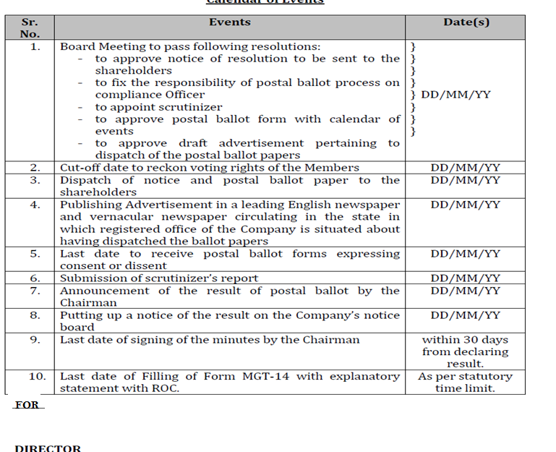

Slide 20
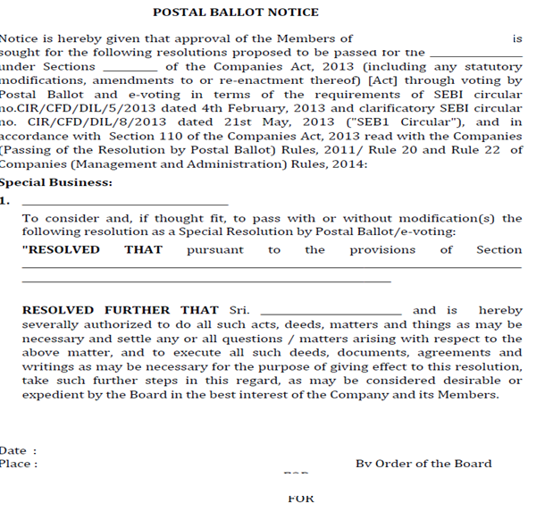

Slide 21
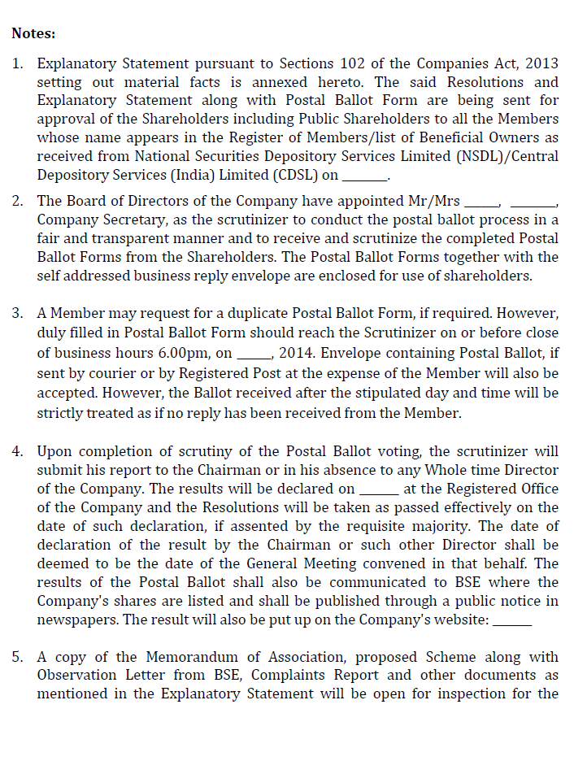
POSTAL BALLOT NOTICE(CONTD…)

Slide 22
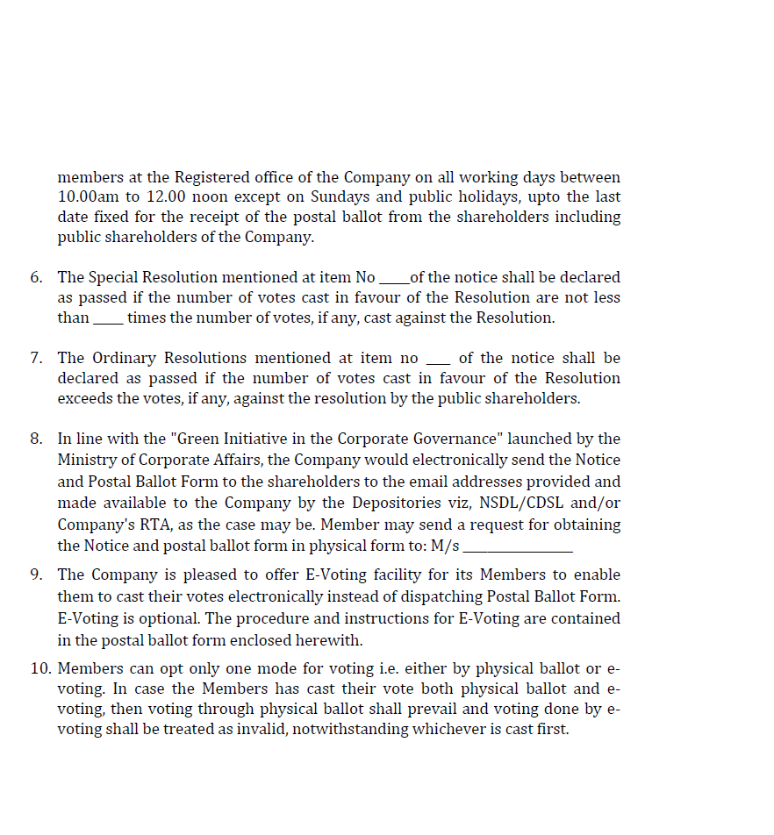
POSTAL BALLOT NOTICE(CONTD…)

Slide 23
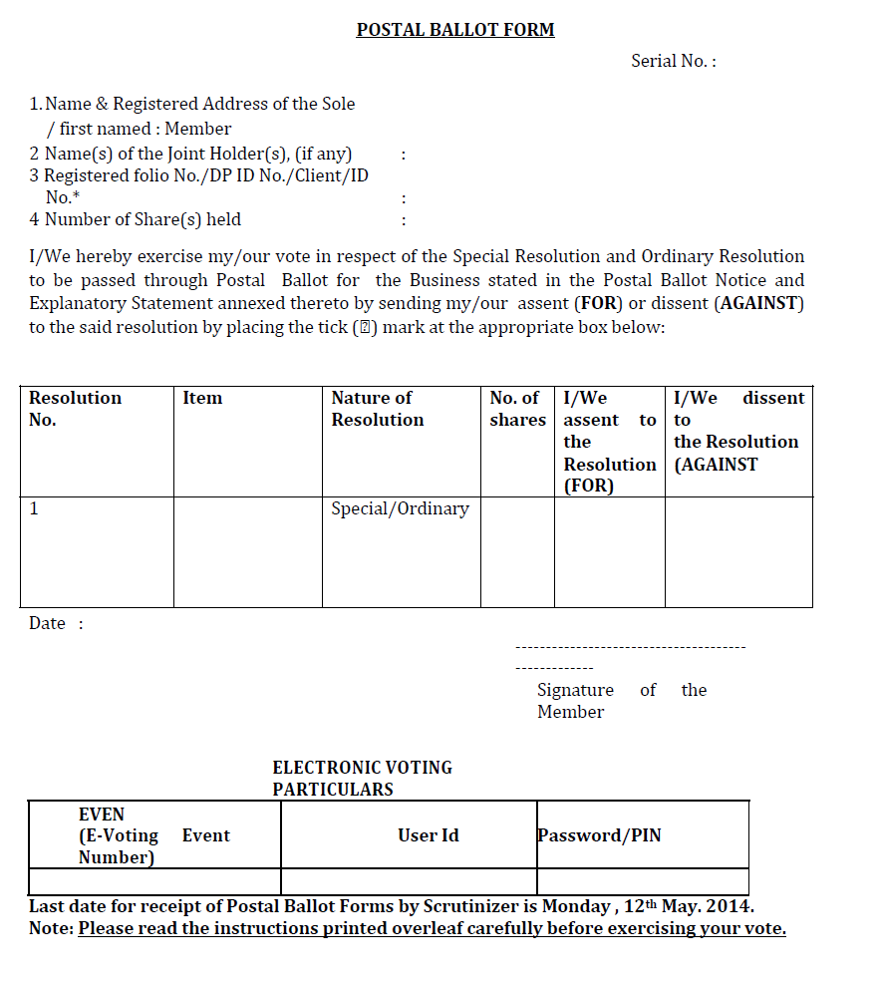
POSTAL BALLOT NOTICE(CONTD…)

Slide 24
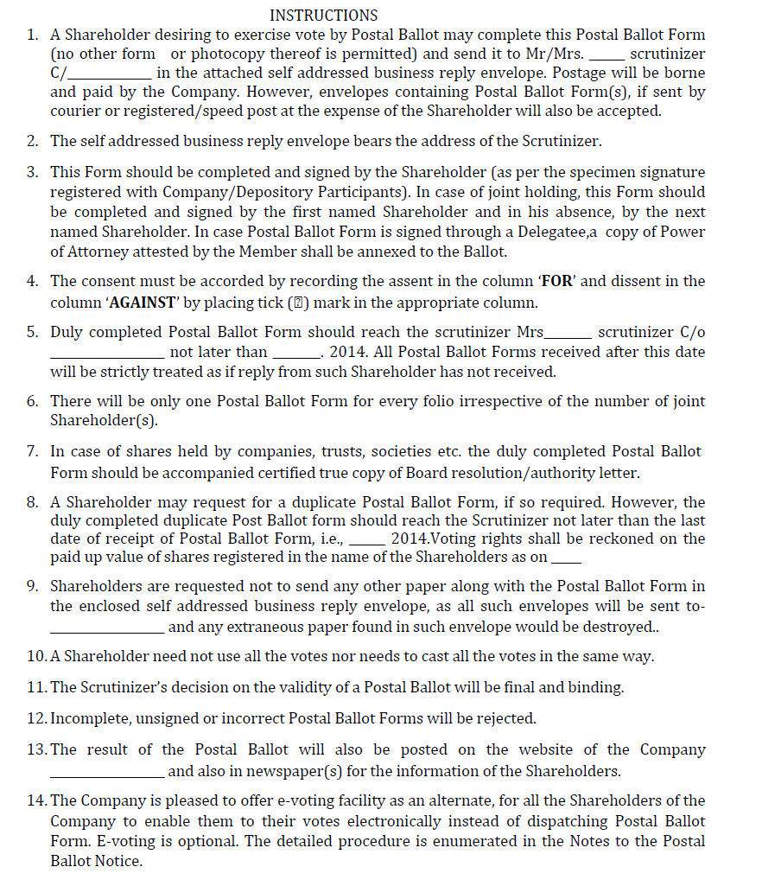
POSTAL BALLOT NOTICE(CONTD…)

Slide 25
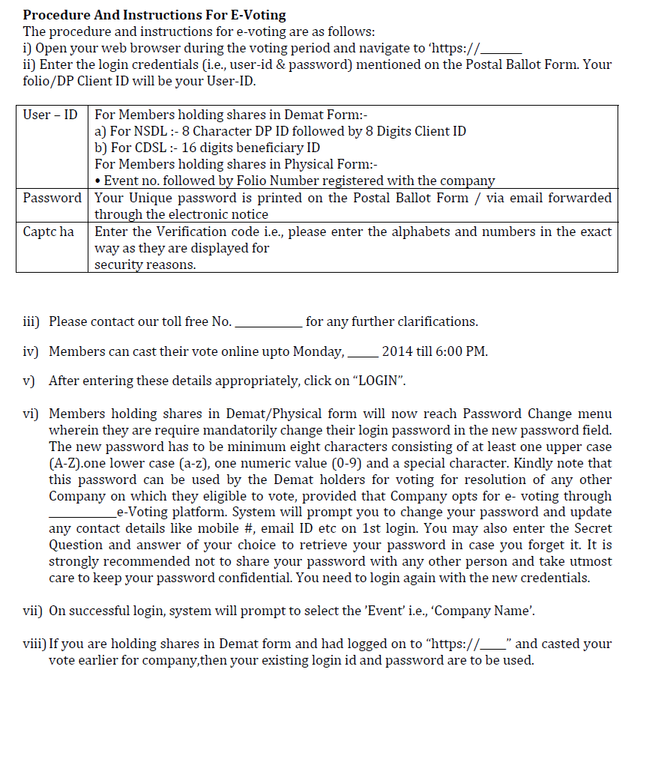
POSTAL BALLOT NOTICE(CONTD…)

Slide 26
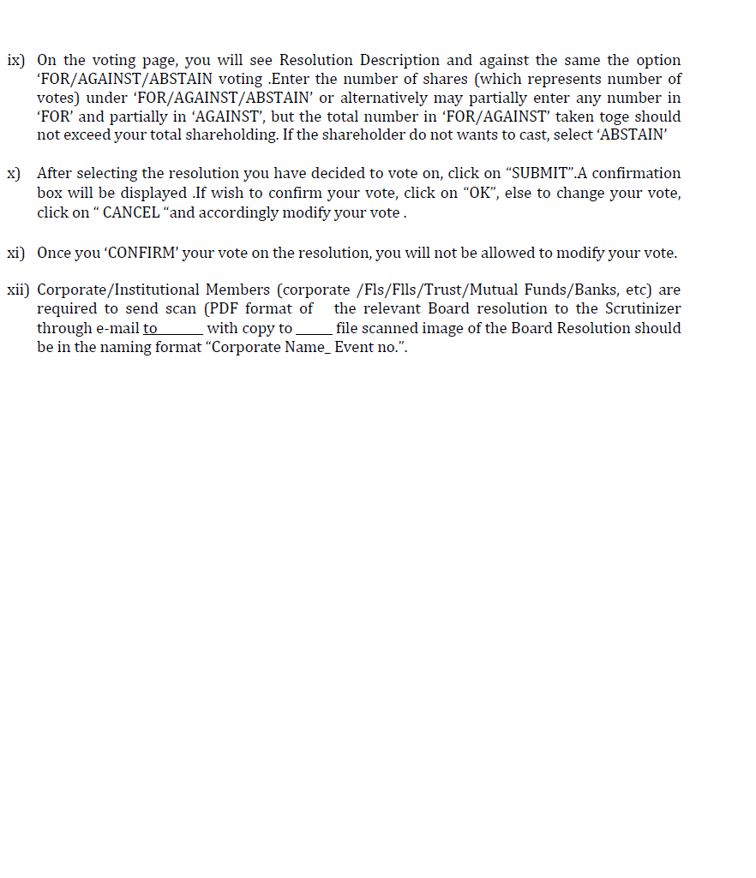
POSTAL BALLOT NOTICE(CONTD…)

Slide 27
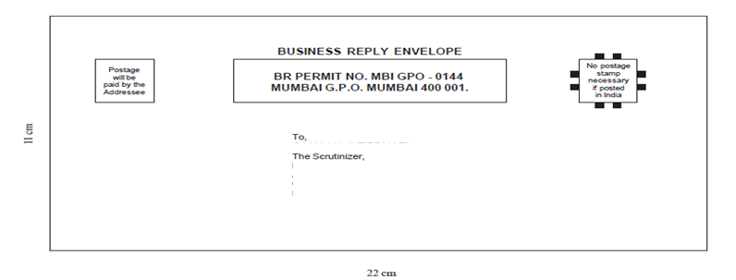

Slide 28


Slide 29
THANK YOU

